Slide 1


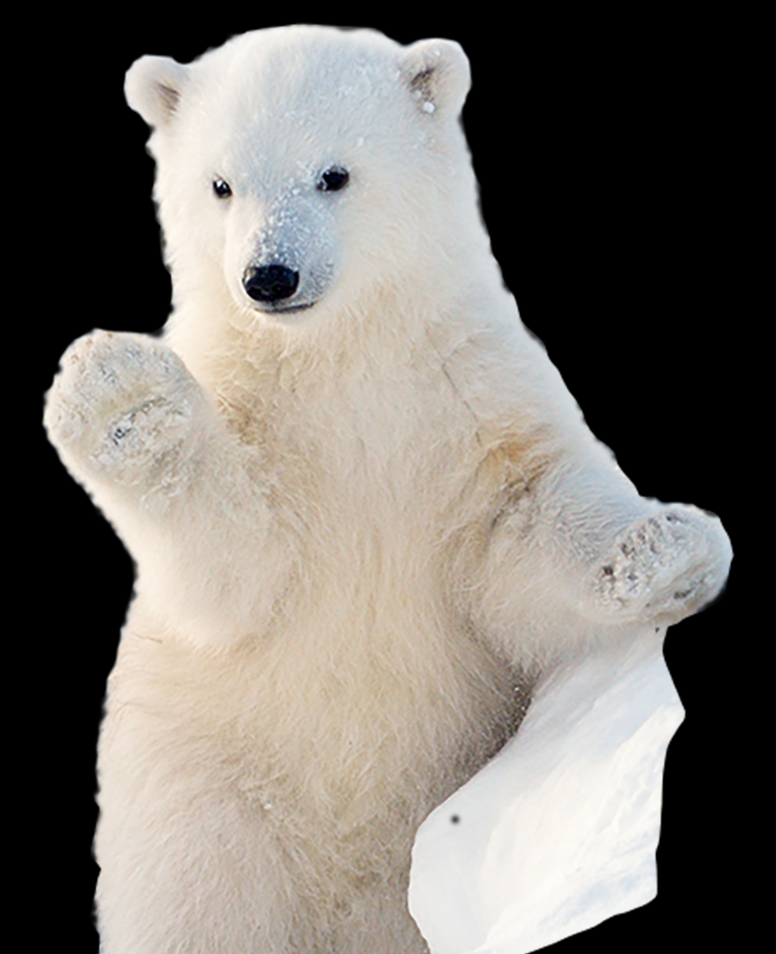


Welcome!

Slide 2

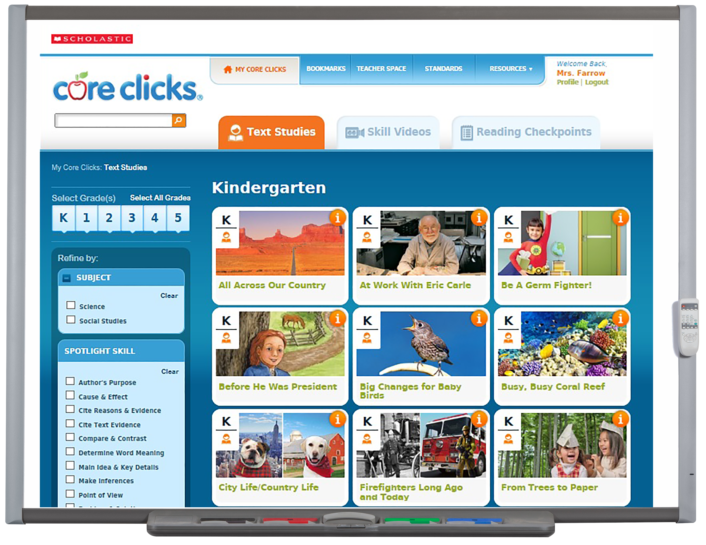
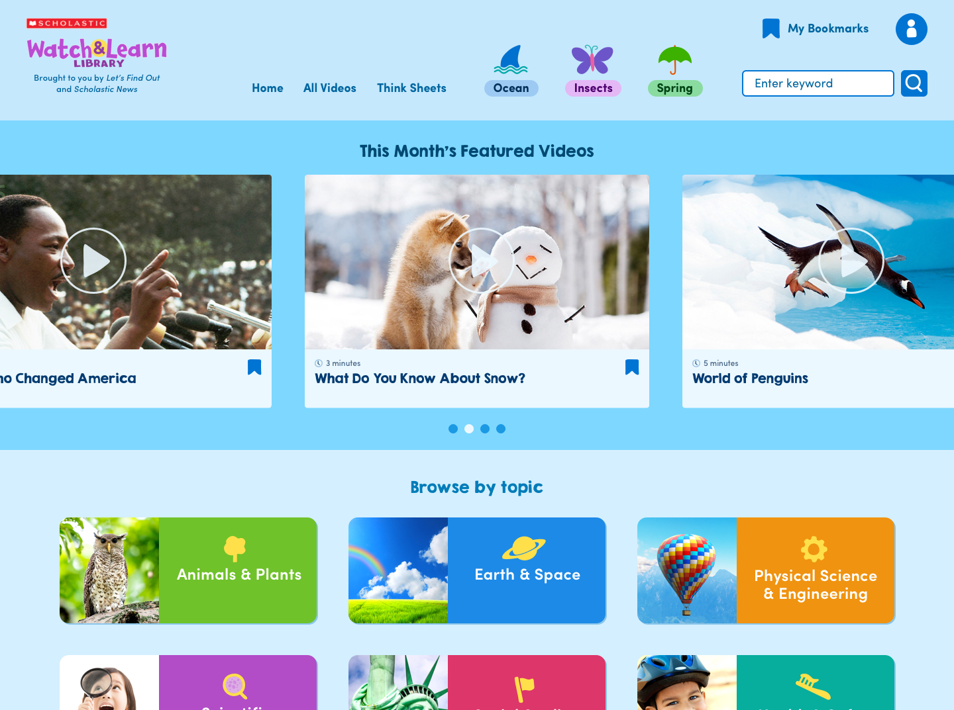
Videos for Kids
Easy to teach. Fun to Watch!

Slide 3
From the editors of Scholastic News &
Let’s Find Out Magazines
230+ curriculum aligned science, social studies & social-emotional videos
Grades PreK-3
Build knowledge & expand content-area vocabulary
Nonfiction
Videos with
real-world footage
English
& Spanish
New videos added every year!

Slide 4
Watch & Learn videos are an essential classroom tool because they:
Build knowledge on all your curriculum topics
Expand vocabulary across the content areas
Engage and inspire with real-world footage
Present concepts that are developmentally-appropriate
Support ELL, Spanish-speaking, and beginning readers
Build knowledge on all curriculum topics
Expand vocabulary across all content areas
Engage and inspire children with real-world footage
Present concepts that are developmentally-appropriate
Support ELL, Spanish-speaking students, and beginning readers
No ads.
No waiting. No searching!

Slide 5
Recent research shows “whether or not readers understand a text depends far more on how much background knowledge and vocabulary they have relating to the topic than on how much they’ve practiced comprehension skills.”
[The Atlantic, 2018]
Research
backed!

Slide 6
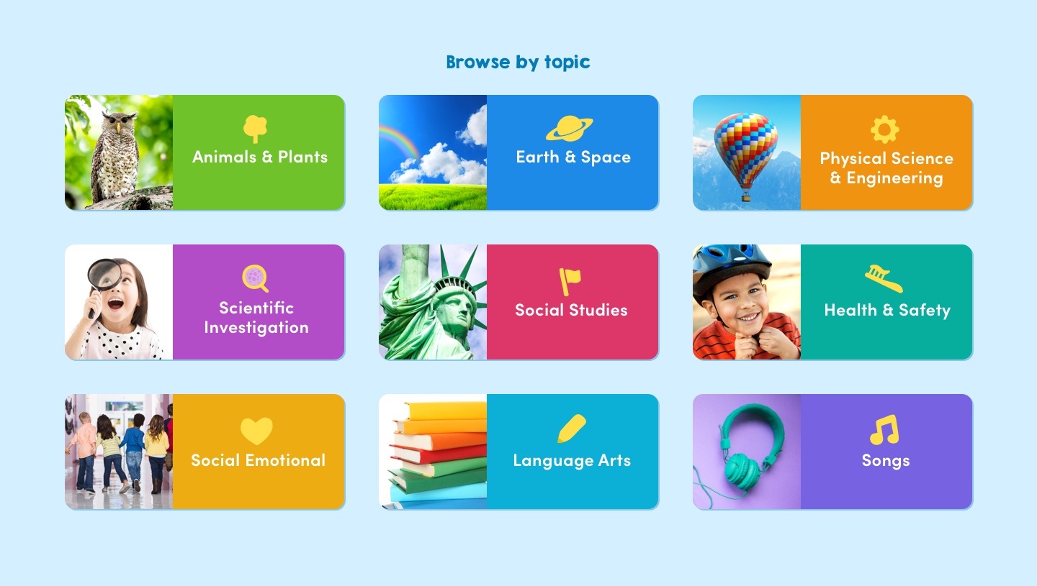

Slide 7
Roly-Poly Polar Bears
Rabbit Roundup
Meet the Lion
Two BIG Cats
All About Elephants
Koala Time
Snow Monkeys Have a Ball
Night Flyer
What Is a Groundhog?
All About Sea Otters
Flip for Dolphins
A Dolphin Is Not a Fish
Get Close to Sharks!
What Are Plants?
World of Penguins
Across the Ice (Emperor Penguins)
Wild About Puffins
Turkey Time
Roosters, Hens, and Chicks!
Reptiles Rule
What Is a Fish?
Eight Extraordinary Facts About Octopuses
Insects, Insects Everywhere
Tricky Spiders
Busy, Busy Bees!
Lovely Little Ladybug
A Pumpkin Grows
An Apple Grows
Leaves Through the Seasons
Investigate Pumpkins
Pumpkin Boat Race
Apples
What Happens at an Apple Orchard
It Came From a Tree
Trees Glorious Trees
Parts of a Plant
Seeds on the Go
What Do Plants Need?
Nature’s Tiny Gardeners

Slide 8
It’s Raining, It’s Pouring
The Power of Wind
Wild Weather
What Do You Know About Snow?
How Animals Can Predict the Weather
All About Clouds
The Water Cycle
Rainbows in the Sky
What's the Weather?
The Sounds of Spring
Autumn Is Here
It Is Autumn!
Signs of Winter
In Like a Lion, Out Like a Lamb
Rocks and Minerals
Volcanoes Blow Their Tops
Inside Cool Caves
Animals of the Ice Age
Here Comes the Sun
What’s in the Night Sky?
Our Incredible Solar System
All About Water
What Are Endangered Animals?
Get Rid of That Trash
Earth Day Every Day
Follow That Bottle!

Slide 9
Make It Move
When Water Freezes
States of Matter
Making Crayons
Cooking Science!
It’s My Shadow
Rainbows in the Sky
Build an Epic Sandcastle
Inventions from Nature
Making Better Bubbles
Up, Up And Away!
Making Macy’s Parade Balloons (Thanksgiving)
Making Crayons
Just Press Print
Problem and Solution
Veronica the Lego Master
Power of Wind
All About Energy
What Changes Over Time?

Slide 10
Making Observations
The Five Senses
Science Tools
Camera Traps
Ocean Exploration
Inventions from Nature
Is It a Living Thing?
What Do Scientists Do?
An Astronaut’s Life
Ben Franklin: Inventor
Volcanologist
Bear Cub Checkup
Keeping Bats Healthy
Inventors

Slide 11
Time to Vote!
Our Flag
Remarkable Landmarks
The Statue of Liberty
The Rules of Our Land
The Story of the Star Spangled Banner
The Declaration of Independence
The White House
American Symbols
Working to Make a Change
The Great Jackie Robinson
Landforms
The Great Jackie Robinson
The Life of Johnny Appleseed
The Story of Tisquantum
The Story of the Pilgrims
A Man Who Changed America
The Life of George Washington
The Life of Abraham Lincoln
Ben Franklin: Inventor (also in Science)
Amazing Amelia Earhart Brave Amelia Earhart
A Map Can Tell You That!
Wildfires
Happy New Year!
Hearts All Around (new)
Thank You, Veterans!
Happy St. Patrick’s Day
Giving Feels Good
What Is Thanksgiving?
100 Days of School
A Man Who Changed America
What Can One Little Person Do? (Rosa Parks)
What Can One Little Person Do? (Dr. King)
Exploring Our World

Slide 12
Find Out About Your Body
How To Have a Healthy Smile
No More Germs!
Let’s Eat!
Food Fuel
Bones, Bones, Bones!
Brush, Brush, Brush Your Teeth
Be Fire Safe!
Be a Fire Safety Expert Get to School the Safe Way
Keep Yourself Safe at School
Safe in the Surf
Protect Your Head
Summer Safety Do’s and Don’ts

Slide 13
Rayanie and Chief
You Can Stop a Bully
You Can Be Responsible!
Kids Take Care
Be a Good Sport
Everyday Manners
All Kinds of Feelings
Choose To Be Kind
Good Citizens
Thanks for Taking Care of Me!
We Can All Be Friends
Ways We Share
Fantastic Friend Countdown
Families
Raina and Ruuxa: Best Friends Forever
Name That Rule!
Fun with School Rules
Five Ways to Try Your Best
Wheelchair Racer

Slide 14
Name That Character Trait
How To Be an Author
Idioms
Problem and Solution (also in Science)
Fiction and Nonfiction
Telling Stories

Slide 15
Fire Truck Song
The Ants Go Marching
Way Up High in the Apple Tree
It Is Autumn!
The National Anthem
I Am Thankful
What Can One Little Person Do? (Rosa Parks)
Wave Goodbye
Apples and Bananas
Leaves, Flowers, Stems and Roots
Brush, Brush, Brush Your Teeth
Go Bananas!
What Can One Little Person Do? (Dr. King)

Slide 16
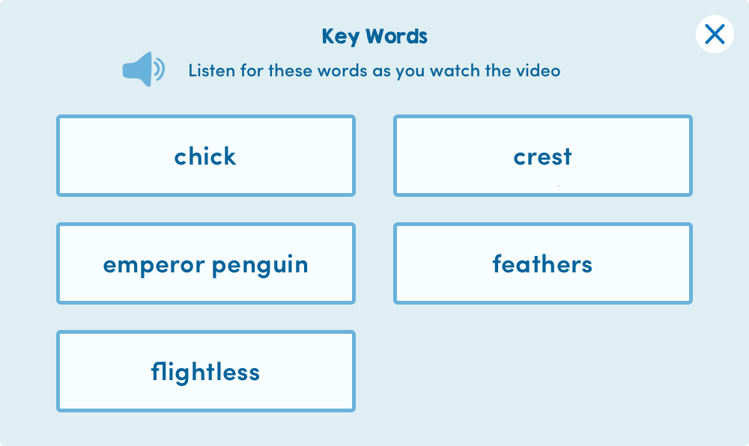
Vocabulary Builder
Introduce key
vocabulary to help
students comprehend
what they’re watching.

Slide 17
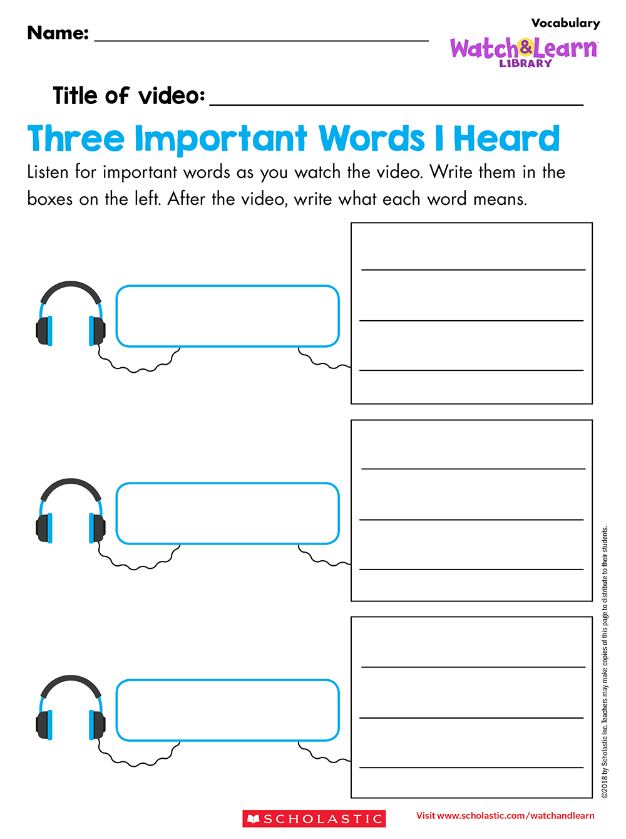
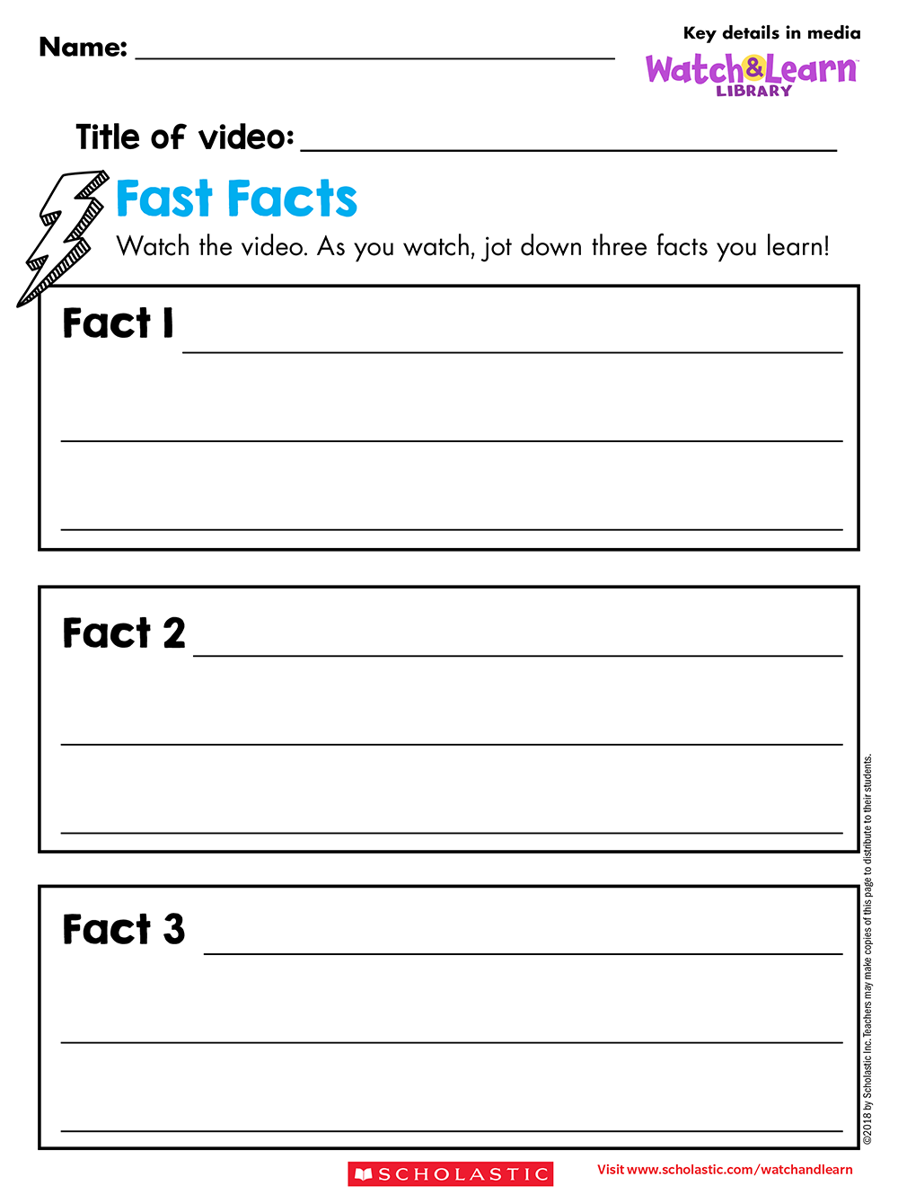
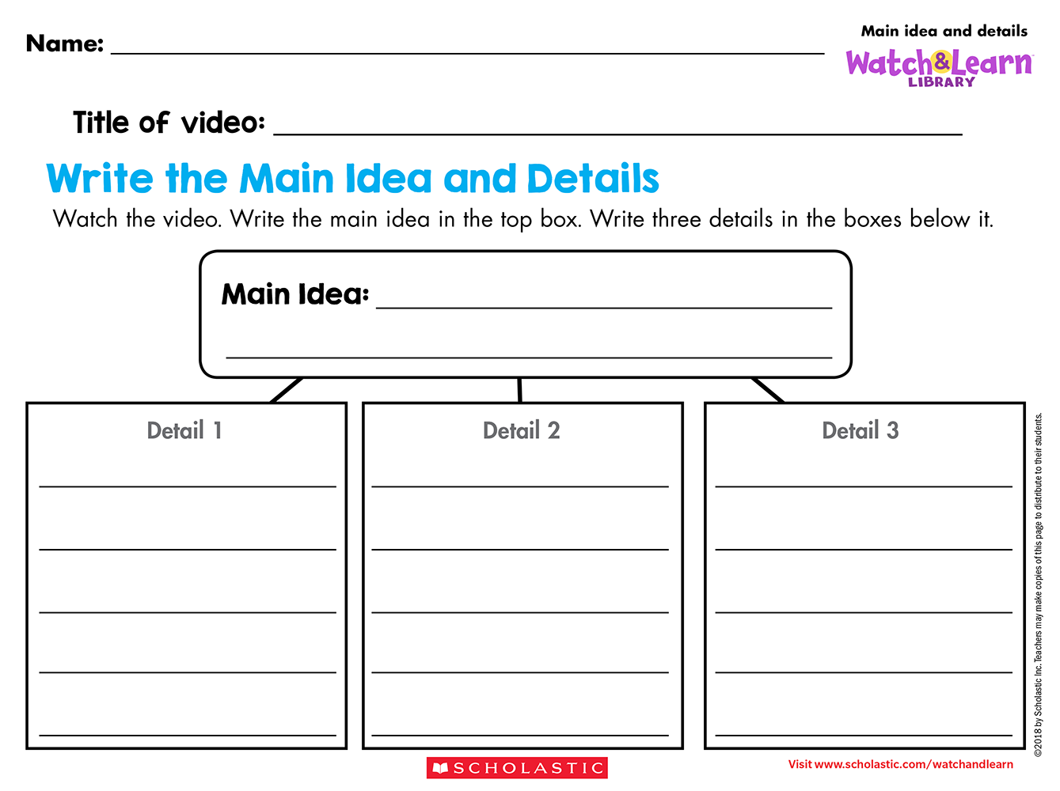
Think Sheets
General use Think Sheets set a purpose for learning
and keep kids focused!

Slide 18
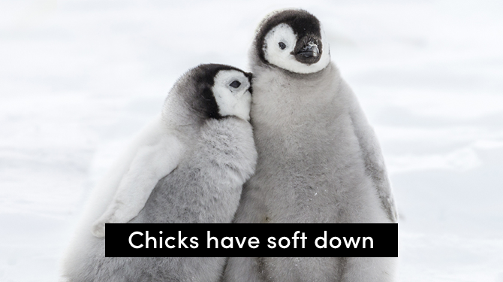
Closed Captioning
for each video supports ELL and beginning readers.

Slide 19
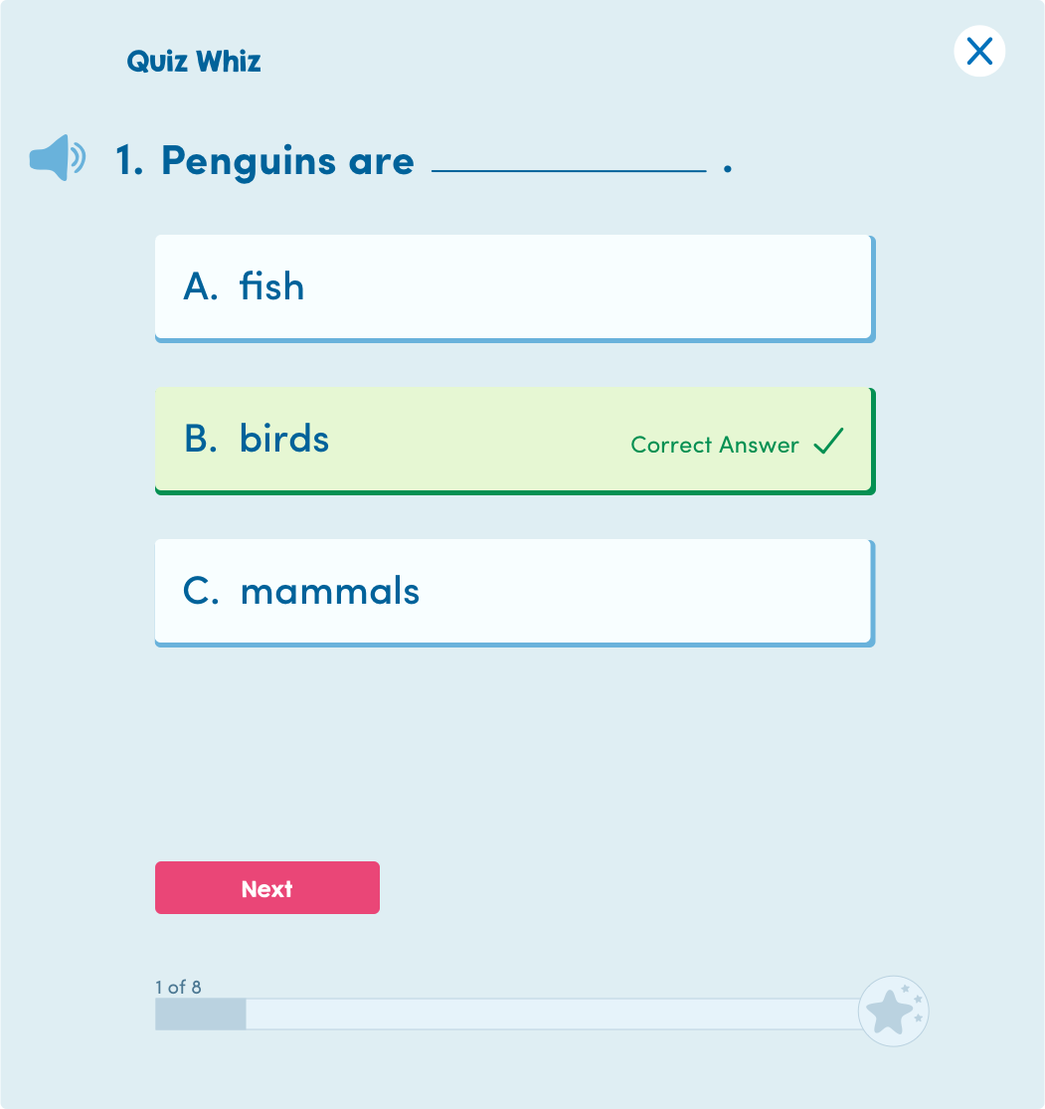
Quiz Whiz!
Test student knowledge
with short, fun quizzes.

Slide 20
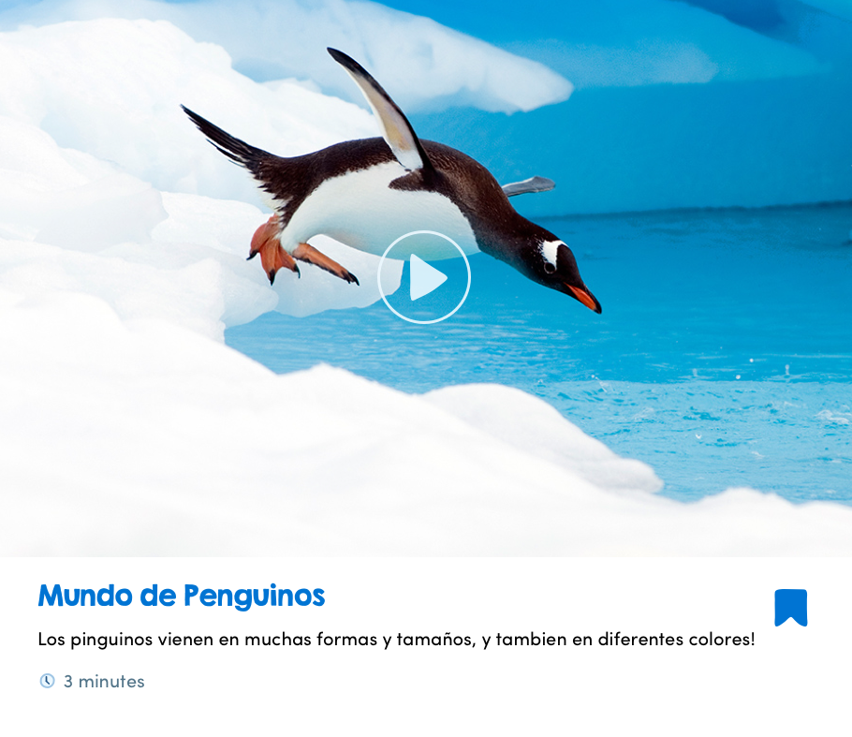
Spanish
All videos with closed captioning, Think Sheets, quizzes, and vocabulary builders are available in Spanish too!

Slide 21
To learn more, request pricing, or place an order, please reach out to our specialists!
Call: 1-800-387-1437 Email: digitalinfo@scholastic.com
Visit: scholastic.com/watchandlearn
Thank
You!

